Slide 1
The Cost of Capital
CHAPTER 9
© 2020 Cengage Learning. All Rights Reserved. May not be copied, scanned, or duplicated, in whole or in part, except for use as permitted in a license distributed with a certain product or service or otherwise on a password-protected website for classroom use.

Slide 2
Topics in Chapter
Cost of capital components
Debt
Preferred stock
Common equity
WACC
Factors that affect WACC
Adjusting cost of capital for risk

Slide 3
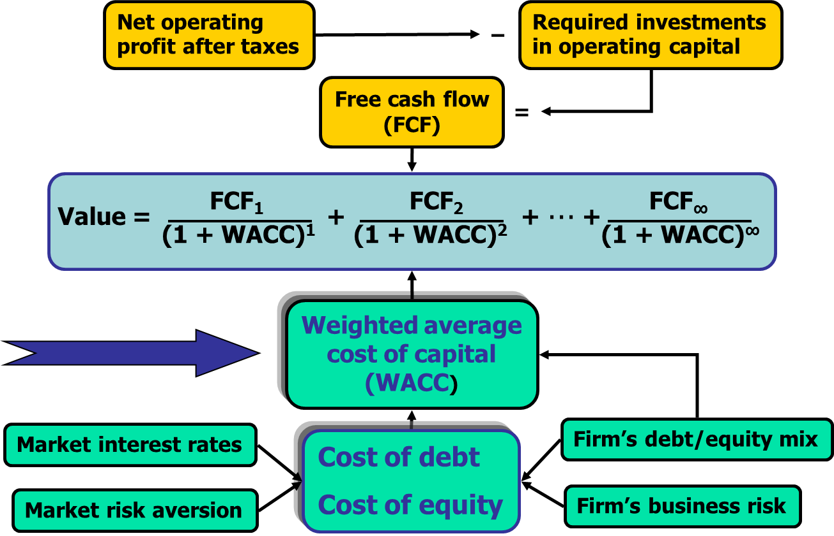
Determinants of Intrinsic Value: The Weighted Average Cost of Capital

Slide 4
What types of long-term capital do firms use?
Long-term debt
Some firms also use permanent short-term debt
Other firms have temporary short-term debt for seasonal fluctuations in inventory, but this is usually not part of the capital structure
Preferred stock
Common equity

Slide 5
Capital Components
Capital components are sources of funding that come from investors.
Accounts payable, accruals, and deferred taxes are not sources of funding that come from investors, so they are not included in the calculation of the cost of capital.
We do adjust for these items when calculating the cash flows of a project, but not when calculating the cost of capital.

Slide 6
Before-tax vs. After-tax Capital Costs
Tax effects associated with financing can be incorporated either in capital budgeting cash flows or in cost of capital.
Most firms incorporate tax effects in the cost of capital. Therefore, focus on after-tax costs.
Only cost of debt is affected.

Slide 7
Historical (Embedded) Costs vs. New (Marginal) Costs
The cost of capital is used primarily to make decisions which involve raising and investing new capital. So, we should focus on marginal costs.

Slide 8
Cost of Debt
Method 1: Ask an investment banker what the coupon rate would be on new debt.
Method 2: Find the bond rating for the company and use the yield on other bonds with a similar rating.
Method 3: Find the yield on the company’s debt, if it has any.

Slide 9
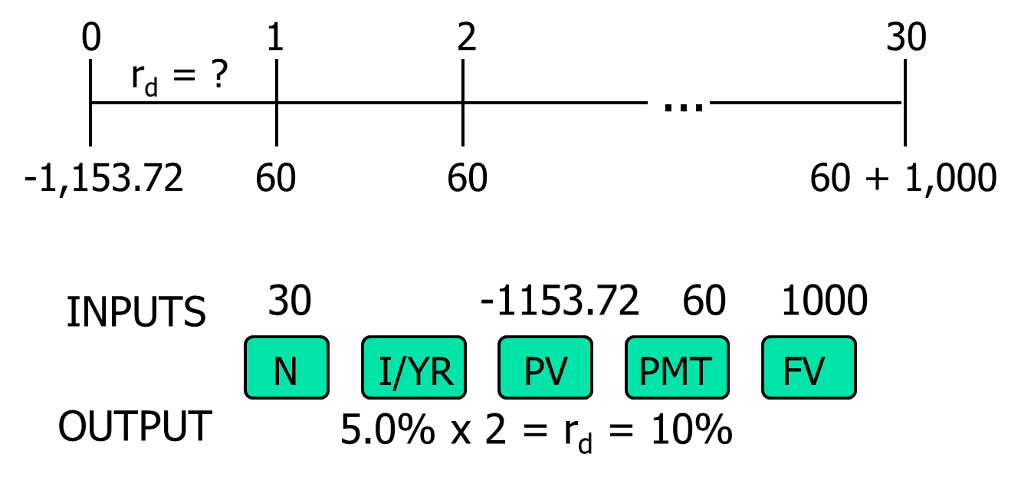
A 15-year, 12% semiannual bond sells for $1,153.72. What’s r_{d}?

Slide 10
Component Cost of Debt
Interest is tax deductible, so the after tax (AT) cost of debt is:
r_{d} AT = r_{d} BT(1 – T)
r_{d} AT = 10%(1 – 0.25) = 7.5%.
Use nominal rate.
Flotation costs small, so ignore.

Slide 11
Cost of preferred stock: P_{ps} = $116.95; 10%Q; Par = $100; F = 5%
Use this formula:

Slide 12
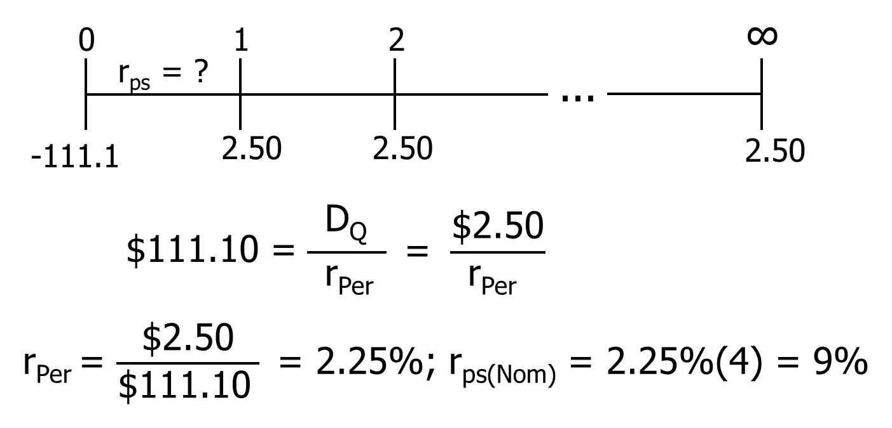
Time Line of Preferred

Slide 13
Note:
Flotation costs for preferred are significant, so are reflected. Use net price.
Preferred dividends are not deductible, so no tax adjustment. Just r_{ps}.
Nominal r_{ps} is used.

Slide 14
Is preferred stock more or less risky to investors than debt?
More risky; company not required to pay preferred dividend.
However, firms want to pay preferred dividend. Otherwise, (1) cannot pay common dividend, (2) difficult to raise additional funds, and (3) preferred stockholders may gain control of firm.

Slide 15
Why is yield on preferred lower than r_{d}?
Corporations own most preferred stock, because 50% of preferred dividends are nontaxable to corporations.
Therefore, preferred often has a lower B-T yield than the B-T yield on debt.
The A-T yield to investors and A-T cost to the issuer are higher on preferred than on debt, which is consistent with the higher risk of preferred.

Slide 16
Example: r_{ps} = 9%, r_{d} = 10%, T = 25%, Preferred exclusion = 50%
r_{ps, AT} = r_{ps} – r_{ps}(1 – % Exclusion)(T)
= 9% – 9%(1 – 0.50)(0.25) = 7.875%
r_{d, AT} = 10% – 10%(0.25) = 7.50%
A-T Risk Premium on Preferred = 0.375%

Slide 17
What are the two ways that companies can raise common equity?
Directly, by issuing new shares of common stock.
Indirectly, by reinvesting earnings that are not paid out as dividends (i.e., retaining earnings).

Slide 18
Why is there a cost for reinvested earnings?
Earnings can be reinvested or paid out as dividends.
Investors could buy other securities, earning a return.
Thus, there is an opportunity cost if earnings are reinvested.

Slide 19
Cost for Reinvested Earnings
Opportunity cost: The return stockholders could earn on alternative investments of equal risk.
They could buy similar stocks and earn r_{s}, or company could repurchase its own stock and earn r_{s}. So, r_{s}, is the cost of reinvested earnings and it is the cost of common equity.

Slide 20
Three ways to determine the cost of equity, r_{s}:
1. CAPM: r_{s} = r_{RF} + (r_{M} – r_{RF})b
= r_{RF} + (RP_{M})b.
2. DCF: r_{s} = D₁/P₀ + g.
3. Own-Bond-Yield-Plus-Judgmental-Risk Premium: r_{s} = r_{d} + Bond RP.

Slide 21
CAPM Cost of Equity: r_{RF} = 5.6%, RP_{M} = 6%, b = 1.2
r_{s} = r_{RF} + (RP_{M} )b
= 5.6% + (6.0%)1.2 = 12.8%.

Slide 22
Issues in Using CAPM (1 of 2)
Most analysts use the rate on a long-term (10 to 20 years) government bond as an estimate of r_{RF}.

Slide 23
Issues in Using CAPM (2 of 2)
Most analysts use a rate of 3.5% to 6% for the market risk premium (RP_{M})
Estimates of beta vary, and estimates are “noisy” (they have a wide confidence interval).

Slide 24
Dividend Growth Cost of Equity, r_{s}: D₀ = $3.26; P₀ = $50; g = 5.8%

Slide 25
Estimating the Growth Rate
Use the historical growth rate if you believe the future will be like the past.
Obtain analysts’ estimates: Value Line, Zacks, Yahoo!Finance.
Use the earnings retention model, illustrated on next slide.

Slide 26
Earnings Retention Model (1 of 2)
Suppose the company has been earning 15% on equity (ROE = 15%) and has been paying out 62% of its earnings.
If this situation is expected to continue, what’s the expected future g?

Slide 27
Earnings Retention Model (2 of 2)
Growth from earnings retention model: g = (Retention rate)(ROE) g = (1 – Payout rate)(ROE)
g = (1 – 0.62)(15%) = 5.7%. This is close to g = 5.8% given earlier.

Slide 28
Could the dividend growth approach be applied if g is not constant?
YES, nonconstant g stocks are expected to have constant g at some point, generally in 5 to 10 years.
But calculations get complicated. See the Ch09 Mini Case.xlsx or see Web 09B worksheet in the file Ch09 Tool Kit.xlsx.

Slide 29
The Own-Bond-Yield-Plus-Judgmental-Risk-Premium Method: r_{d} = 10%, RP = 3.2%
r_{s} = r_{d} + Judgmental risk premium
r_{s} = 10.0% + 3.2% = 13.2%
This judgmental-risk premium ≠ CAPM equity risk premium, RP_{M}.
Produces ballpark estimate of r_{s}. Useful check.=

Slide 30
What’s a reasonable final estimate of r_{s}?
Method | Estimate
CAPM | 12.8%
Dividend growth | 12.4%
r_{d} + judgment | 13.2%
Average | 12.8%

Slide 31
Determining the Weights for the WACC
The weights are the percentages of the firm that will be financed by each component.
If possible, always use the target weights for the percentages of the firm that will be financed with the various types of capital.

Slide 32
Target Weights
w_{d} = 30%
w_{ps} = 10%
w_{s} = 60%

Slide 33
Estimating Weights for the Capital Structure (1 of 6)
If you don’t know the targets, it is better to estimate the weights using current market values than current book values.
Calculate the market value of debt if you have the information.
If you don’t know the market value of debt, then it is usually reasonable to use the book values of debt, especially if the debt is short-term.

Slide 34
Estimating Weights for the Capital Structure (2 of 6)
Debt
Price = $1,153.72
70,000 bonds
Market value of debt:
$1,153.72(70,000) = $80,760,400.
Approximately equal to $80.76 million.

Slide 35
Estimating Weights for the Capital Structure (3 of 6)
Preferred stock
Price = $116.95
200,000 shares
Market value of preferred stock:
$116.95(200,000) = $23,390,000.
Equal to $23.90 million.

Slide 36
Estimating Weights for the Capital Structure (4 of 6)
Common stock
Price = $50.00
3 million shares
Market value of preferred stock:
$50.00(3) = $150 million.

Slide 37
Estimating Weights for the Capital Structure (5 of 6)
Market value:
Debt = $80.76 million
Preferred = $23.30 million
Common = $150 million
Total value = $254.60 million

Slide 38
Estimating Weights for the Capital Structure (6 of 6)
Market value weights:
Debt = $80.76/$254.60 = 31.79%
Pref. = $23.30/$254.60 = 9.17%
Common = $150/$254.60 = 59.04%
The market value weights are very close to the target weights.

Slide 39
What’s the WACC using the target weights?
WACC = w_{d}r_{d}(1 – T) + w_{ps}r_{ps} + w_{s}r_{s}
WACC = 0.3(10%)(1 − 0.25) + 0.1(9%)
+ 0.6(12.8%)
WACC = 10.83%

Slide 40
What factors influence a company’s WACC?
Uncontrollable factors:
Market conditions, especially interest rates.
The market risk premium.
Tax rates.
Controllable factors:
Capital structure policy.
Dividend policy.
Investment policy. Firms with riskier projects generally have a higher cost of equity.

Slide 41
Is the firm’s WACC correct for each of its divisions?
NO! The composite WACC reflects the risk of an average project undertaken by the firm.
Different divisions may have different risks. The division’s WACC should be adjusted to reflect the division’s risk and capital structure.

Slide 42
The Risk-Adjusted Divisional Cost of Capital
Estimate the cost of capital that the division would have if it were a stand-alone firm.
This requires estimating the division’s beta, cost of debt, and capital structure.

Slide 43
Pure Play Method for Estimating Beta for a Division or a Project
Find several publicly traded companies exclusively in project’s business.
Use average of their betas as proxy for project’s beta.
Hard to find such companies.

Slide 44
Accounting Beta Method for Estimating Beta
Run regression between project’s ROA and S&P Index ROA.
Accounting betas are correlated (0.5 – 0.6) with market betas.
But normally can’t get data on new projects’ ROAs before the capital budgeting decision has been made.

Slide 45
Divisional Cost of Capital Using CAPM (1 of 2)
Target debt ratio = 10%.
r_{d} = 12%.
r_{RF} = 5.6%.
Tax rate = 25%.
beta_{Division} = 1.7.
Market risk premium = 6%.

Slide 46
Divisional Cost of Capital Using CAPM (2 of 2)
Division’s required return on equity:
r_{s} = r_{RF} + (r_{M} – r_{RF})b_{Div.}
r_{s} = 5.6% + (6%)1.7 = 15.8%.
WACC_{Div.} = w_{d} r_{d}(1 – T) + w_{s}r_{s}
= 0.1(12%)(1 – 0.25) + 0.9(15.8%)
= 15.12%

Slide 47
Division’s WACC vs. Firm’s Overall WACC?
Division WACC = 15.12% versus company WACC = 10.83%.
“Typical” projects within this division would be accepted if their returns are above 15.12%.

Slide 48
What are the three types of project risk?
Stand-alone risk
Corporate risk
Market risk

Slide 49
How is each type of risk used?
Stand-alone risk is easiest to calculate.
Market risk is theoretically best in most situations.
However, creditors, customers, suppliers, and employees are more affected by corporate risk.
Therefore, corporate risk is also relevant.

Slide 50
A Project-Specific, Risk-Adjusted Cost of Capital
Start by calculating a divisional cost of capital.
Use judgment to scale up or down the cost of capital for an individual project relative to the divisional cost of capital.

Slide 51
Costs of Issuing New Common Stock
When a company issues new common stock they also have to pay flotation costs to the underwriter.
Issuing new common stock may send a negative signal to the capital markets, which may depress stock price.

Slide 52
Four Mistakes to Avoid
Current vs. historical cost of debt
Mixing current and historical measures to estimate the market risk premium
Book weights vs. Market Weights
Incorrect cost of capital components
See next slides for details.

Slide 53
Current vs. Historical Cost of Debt
When estimating the cost of debt, don’t use the coupon rate on existing debt, which represents the cost of past debt.
Use the current interest rate on new debt.

Slide 54
Estimating the Market Risk Premium
When estimating the risk premium for the CAPM approach, don’t subtract the current long-term T-bond rate from the historical average return on common stocks.
For example, if the historical r_{M} has been about 12.2% and inflation drives the current r_{RF} up to 10%, the current market risk premium is not 12.2% – 10% = 2.2%!

Slide 55
Estimating Weights
Use the target capital structure to determine the weights.
If you don’t know the target weights, then use the current market value of equity.
If you don’t know the market value of debt, then the book value of debt often is a reasonable approximation, especially for short-term debt.

Slide 56
Capital components are sources of funding that come from investors.
Accounts payable, accruals, and deferred taxes are not sources of funding that come from investors, so they are not included in the calculation of the WACC.
We do adjust for these items when calculating project cash flows, but not when calculating the WACC.

